Slide 1

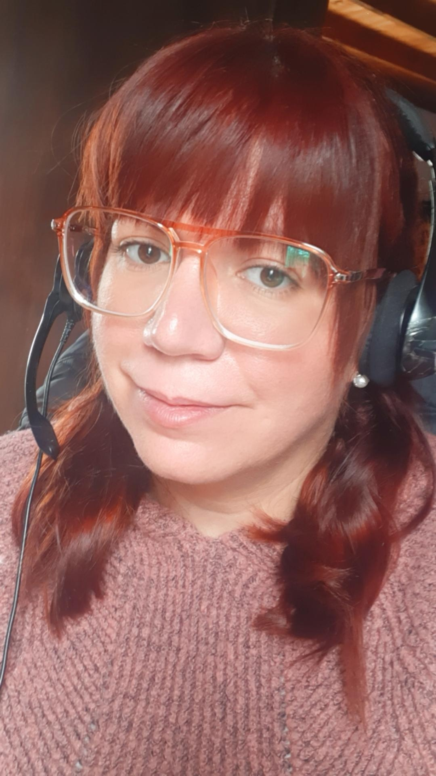

Sofia Danibal
SELECTED EXPERIENCE
PM & Scrum @ Accenture, ARG
Role Title: PM & Scrum
AI Team
ML, Azure, Python
Technical Lead @ Accenture, ARG
Role Title: Technical Lead
Project: Grupo Petersen
Blue Prism
QA @ Accenture, ARG
Role Title: QA
Project: Prisma Medios de Pagos
Blue Prism
Sr. Developer @ Accenture, ARG
Role Title: Sr. Developer
Project: Banco Galicia
Blue Prism
Semi Sr. Developer @ Accenture, ARG
Role Title: Sr. Developer
Projects: Banco Santander, HSBC
Blue Prism
Backend Developer @ Medcenter, ARG
Role Title: Backend Developer
Project: Medcenter
PHP, SQL, Crystal Report
Technical Support @ Realmedia, ARG
Role Title: Technical Support
Projects: Coca-Cola, Disney, Mercado Libre
OAS RealMedia
Data Engineering Specialist
Technology / Data & AI
sofia.danibal@accenture.com
Buenos Aires, Argentina
13 years in the systems area and more than 7 years working in process automation, in different languages. She developed the role of Team Lead, QA and Technical Architect for automations in the Blue Prism tool and Automation Anywhere. She was part of different projects in the financial services industry, where different processes were automated, mostly financial and administrative. She is currently developing as a PM & Scrum on a ML project for the AI team.
AREA OF EXPERTISE
PROFESSIONAL BACKGROUND
HARD/SOFT SKILLS & TOOLS
Dev: SQL, Java, C++, C#, Python, PHP, JS
DB: Oracle/SQLServer/PostgreSQL/ MySQL/MongoDB/Cassandra
AI: AzureML/AzureFunctions/TensorFlow/
YOLO
Others: GIT, Docker, APIS’s, Azure DevOps, Software Architecture, Team leadership, Agile methodologies
EDUCATION
Tecnicatura en Informatica - graduated
Licenciatura en Sistemas – in progress (UNGS)
INDUSTRY
LANGUAGES
Energy - Banking
Oil & Gas – Retail
English (B1)
Spanish (Native)
Accenture
4

